Slide 1
Integrating Movement and Hands On Learning
Dr. Jacob Wolf
ED Program Facilitator

Slide 2
Objectives
Why is movement important
Impact of trauma on brain development and school performance
How movement builds social connections and relationships
Calming vs. alerting movement activities
Integrating movement and hands on learning into academics

Slide 3
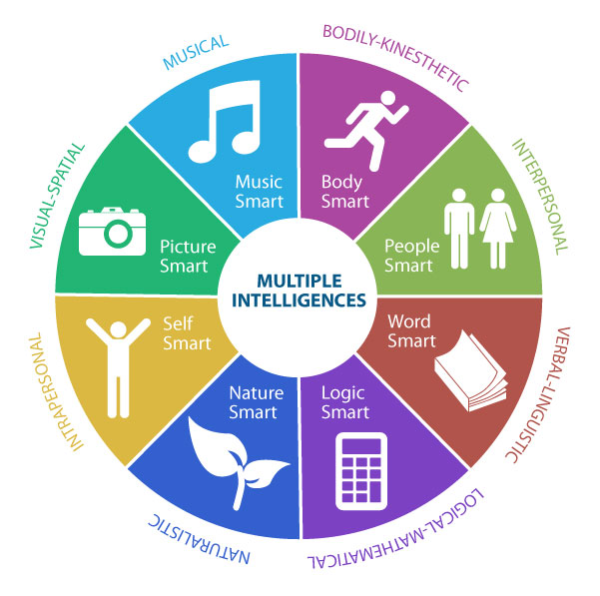
Why is Movement Important to Learning?
Increases brain development and Neuron connections
Access different areas of the brain for learning
Fosters connection with others and emotional regulation

Slide 4
Life Cycle of the Brain

Slide 5
Warning!!! Use Caution!!!

Slide 6
Lazy 8’s Eye movement

Slide 7
Brain States & Movement

Slide 8
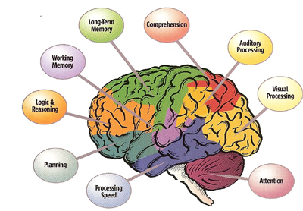
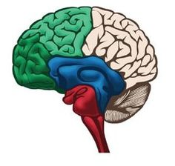
What’s with all the trauma Talk?

Slide 9
What’s with all the trauma Talk?

Slide 10
Common Skill Deficits in Students Who Have Experienced Trauma
Difficulty in working in groups
Difficulty in being able to self-calm in a socially-appropriate fashion
Difficulty in being able to handle making a mistake without losing their cool
Difficulty following directions given by an authority
Challenges with fine and/or gross motor coordination
Difficulty being able to think abstractly
Propensity to sensory over-stimulation
Difficulty organizing their thinking (e.g., sequencing, processing) with ease

Slide 11
Things that inhibit learning
Lack of water intake
Increased stress = Decreased Brain Membrane Potential
Nutrition
Increased stress
More Competitive sports
Sleep

Slide 12
TV, Video Games, Computers
Decreased imaginative development
Increased stressed
Increased violence
Decreased interactive communication
Ocular Lock
Social Media Impact – Dopamine impact
Decreased Movement

Slide 13
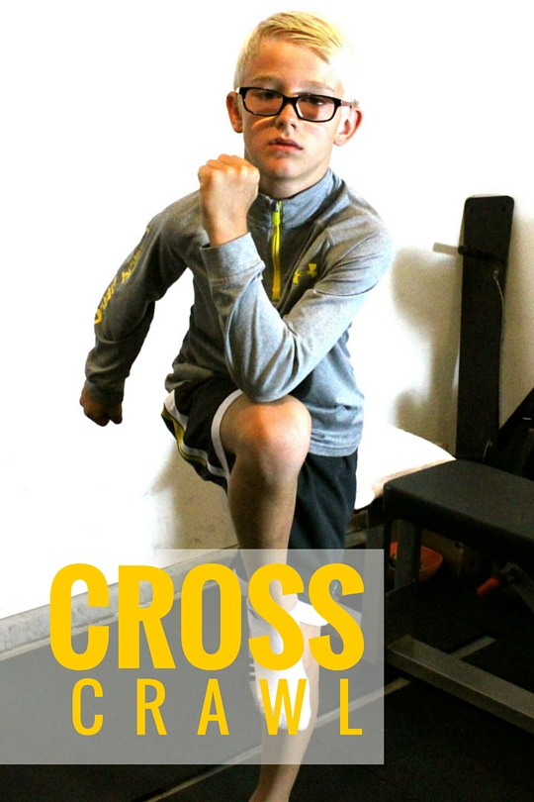
Crossing Midline
Success in many academic skills is based off whether a child can consistently cross the midline with minimal issues:
Writing
Forming letters, Reversals
Reading
Books, board/screen reading
Math
Forming numbers, counting manipulatives

Slide 14
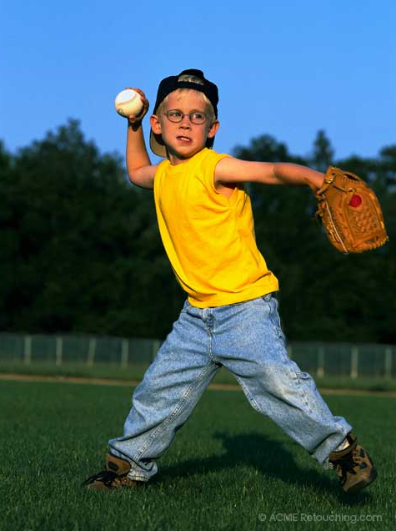
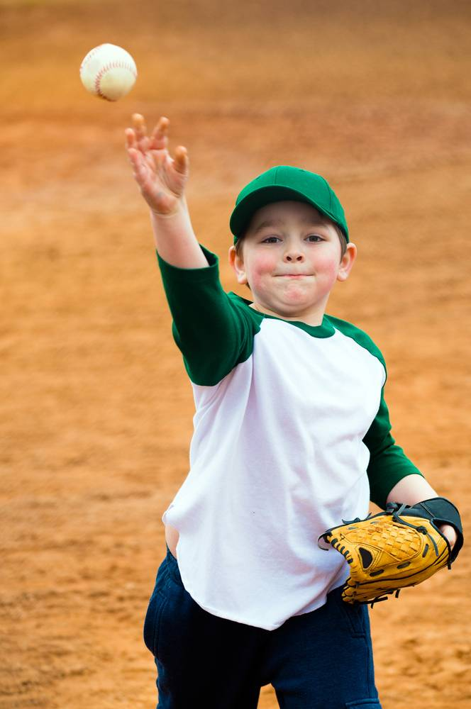
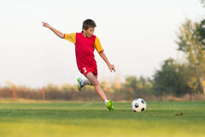
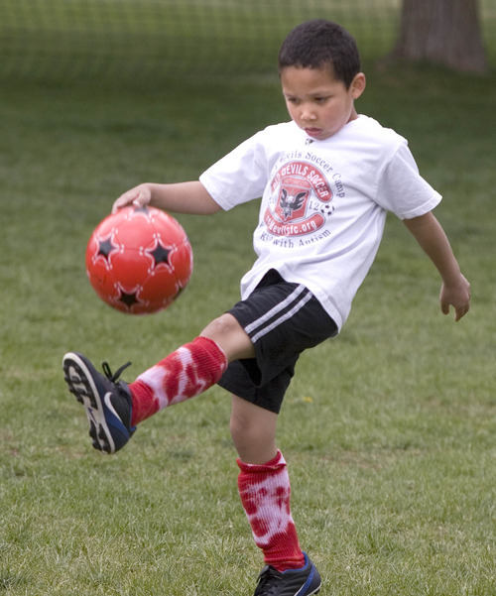
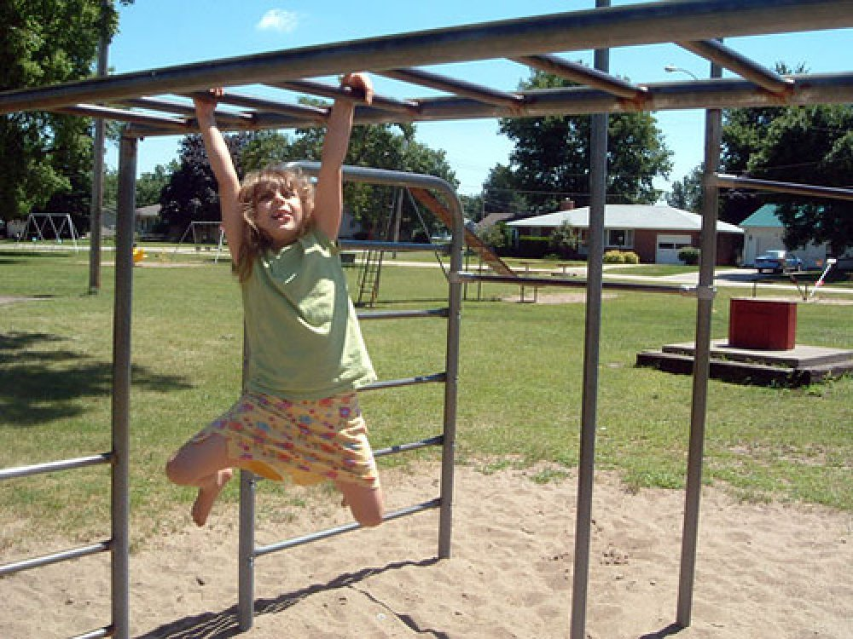
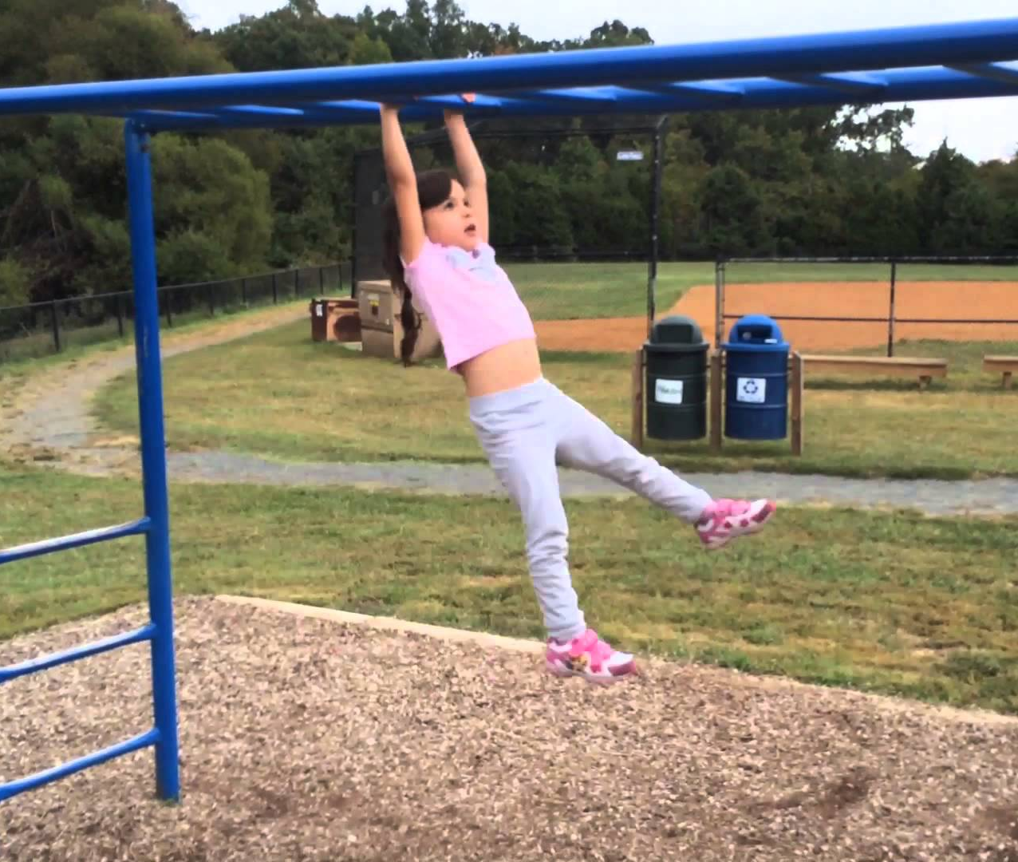
Why is Recess and PE important for Children?

Slide 15
Conscious Discipline & Social Connections
Get into a calm emotional state
Establish a safe and trusting community
Connect with others and build community

Slide 16
Conscious Discipline - Brain Smart Start
Activity should:
Unite everyone by doing something together
Disengage stress and involve deep breathing and stretching
Connect students to the adult and peers
Committee oneself to learning and involve affirmations and positive thinking

Slide 17
https://www.youtube.com/watch?time_continue=79&v=HXhDQW3-OxA

Slide 18
https://www.youtube.com/watch?v=I0jgcyfC2r8

Slide 19
Partner Connection Activities

Slide 20
Card Organizing
Use to mix students into groups, help stretch and move or prepare for a collaborative effort. Distribute playing cards 2-9 (by suit if possible) to each table. Place them face down.
Students each take a card and (without looking at the card) place it on their foreheads.
Now students are instructed to organize themselves without talking by number. This is easily accomplished, and the group is ready to hear the next instruction.

Slide 21
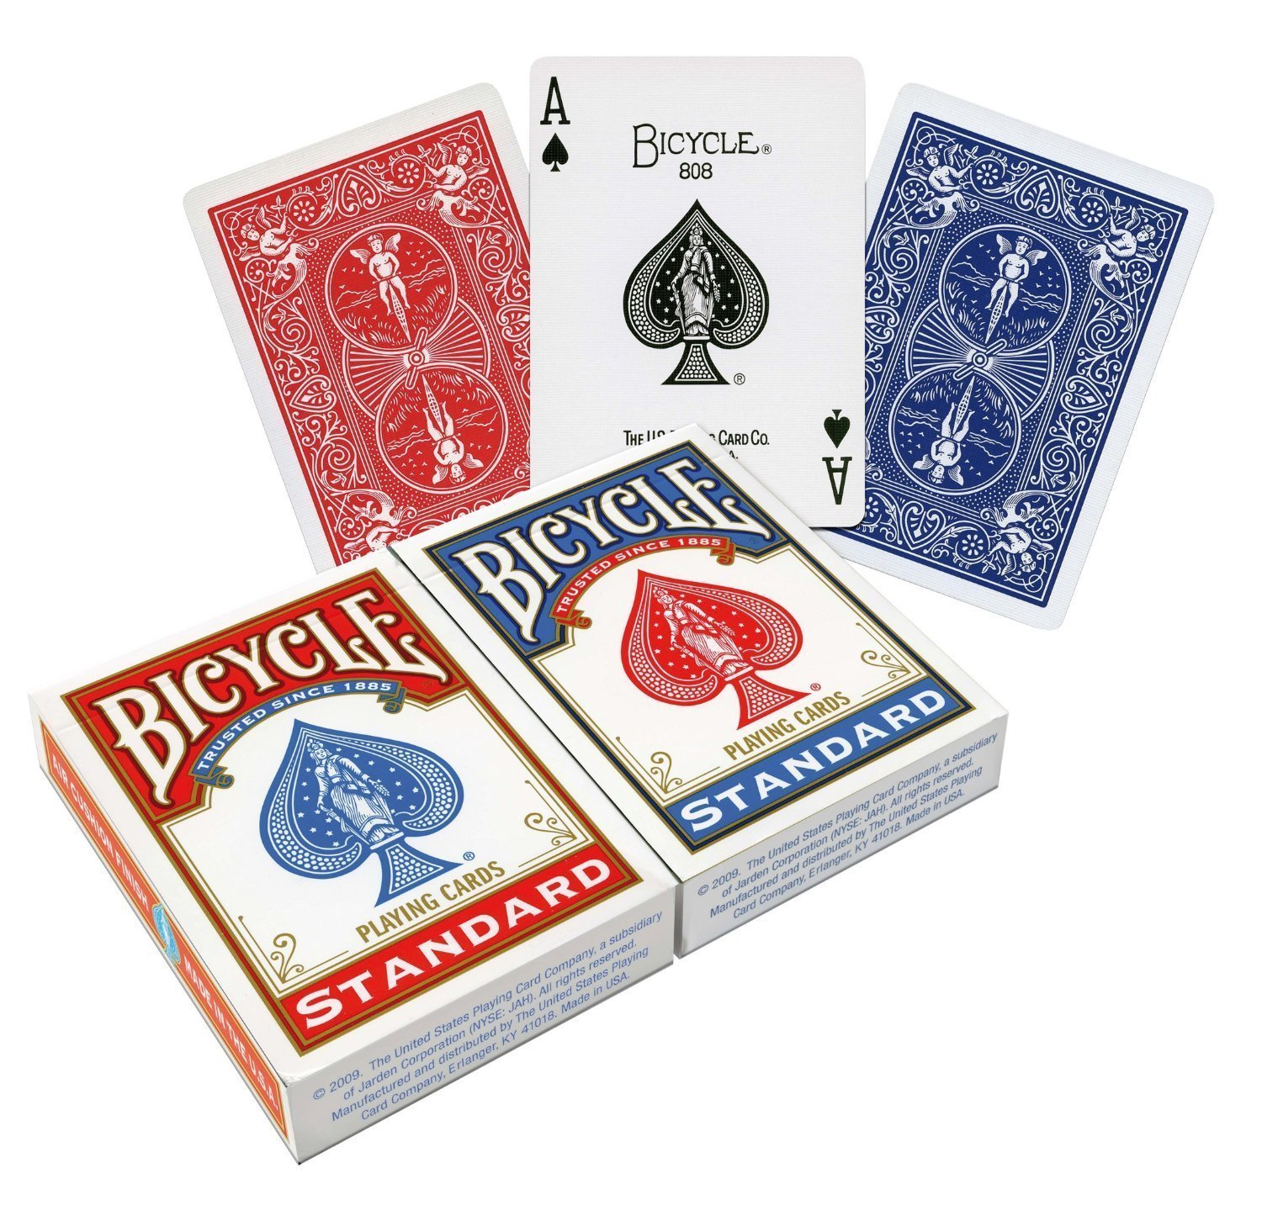
Card Organizing Activity helps with:
Social connection / Nice ice breaker game
Work on vocabulary skills
Verbal expression
Math – you could modify to be different numbers

Slide 22
https://www.youtube.com/watch?v=HDIjKJKCBOk

Slide 23
Ways to modify:
Ice breaker- say person’s name you are passing it to
Do using skip counting
Multiplication facts
Work on vocabulary by picking a starting letters and saying words that start with that letter
One person says a state the next says the capital
Go through alphabet

Slide 24
https://www.youtube.com/watch?v=S5Def617lc0&list=PL9B7990F3F78CCB19&index=4&feature=plpp_video

Slide 25
Ways to modify:
Vocabulary building- Saying words that start with a certain letter or words related to a specific topic
Skip counting
Alphabet
Multiplication facts

Slide 26
https://www.youtube.com/watch?v=LwP9ISlu5cQ&index=6&list=PLS6iL38ozA1bEIspK__Up3DurQoEWhImz

Slide 27
2-2-1 Shuffle https://www.youtube.com/watch?v=JIxnT3ZWFFs

Slide 28
https://www.youtube.com/watch?v=YJzhS46dIOs

Slide 29
Attention Focus-Calming Activities

Slide 30
https://www.youtube.com/watch?v=0oeWjOcwPmA&index=2&list=PLS6iL38ozA1bEIspK__Up3DurQoEWhImz

Slide 31
https://www.youtube.com/watch?v=ZH6QI8OjkZA

Slide 32
Start 50 seconds into video https://www.youtube.com/watch?v=GLWxRiBq7ek

Slide 33
Let’s try it

Slide 34
https://www.youtube.com/watch?v=Ocn2SvhF_rc

Slide 35
Attention Focus-Alerting Activities

Slide 36
https://www.youtube.com/watch?v=RHhBYNoQekk

Slide 37
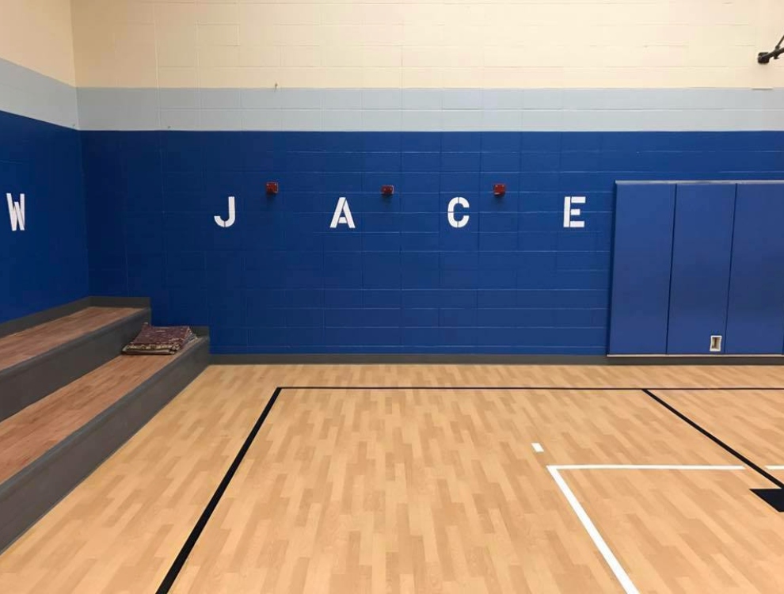
Elementary school gyms with Letters
Many of our elementary schools have letters painted on the wall
This can be used for spelling activities

Slide 38
Curriculum Integration with Movement

Slide 39
Examples of Patterned Rhythmic Movement

Slide 40
https://www.youtube.com/watch?v=thn8W_zJab4&list=PLS6iL38ozA1bEIspK__Up3DurQoEWhImz&index=11

Slide 41
https://www.youtube.com/watch?v=Zx9a7sxVeNM&list=PLS6iL38ozA1bEIspK__Up3DurQoEWhImz&index=36

Slide 42
https://www.youtube.com/watch/?v=aLD9l8foH-k

Slide 43
https://www.youtube.com/watch?v=DfbAQTsP6u8

Slide 44
Problem Solving https://www.youtube.com/watch/?v=WforXEBMm5k

Slide 45
Hands on learning

Slide 46
We need to Limit the amount of worksheets

Slide 47
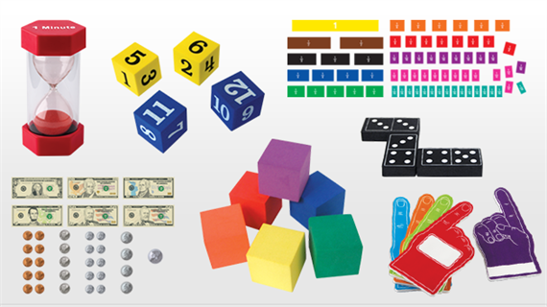
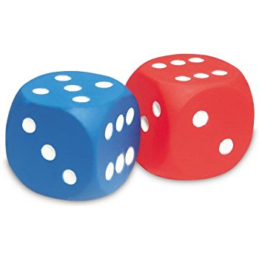
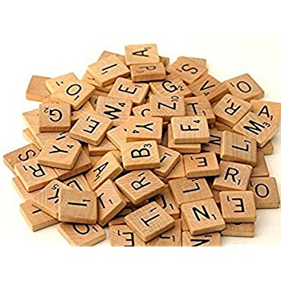
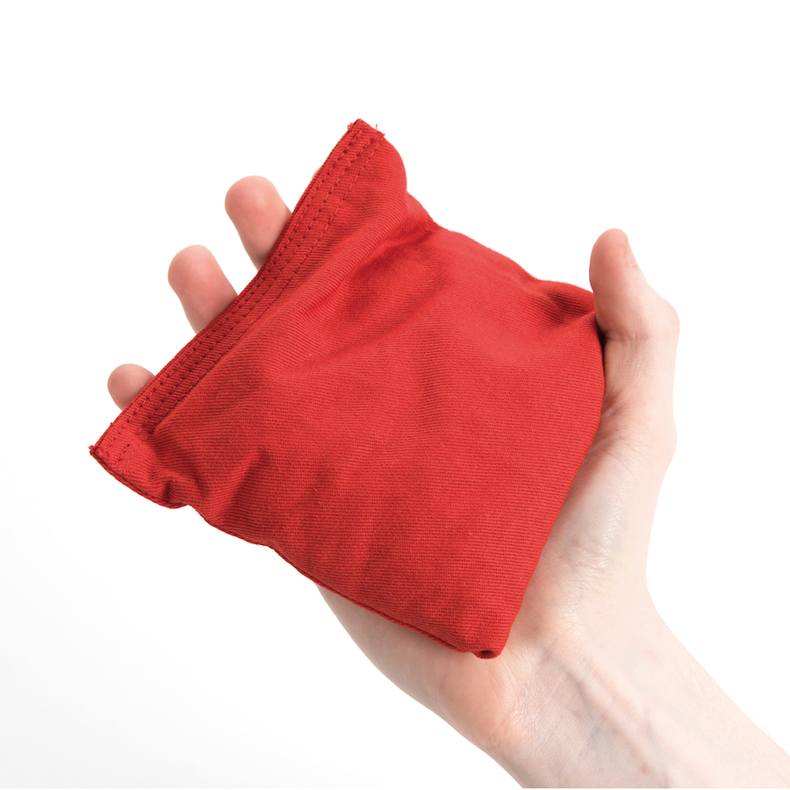
Hands On Learning

Slide 48
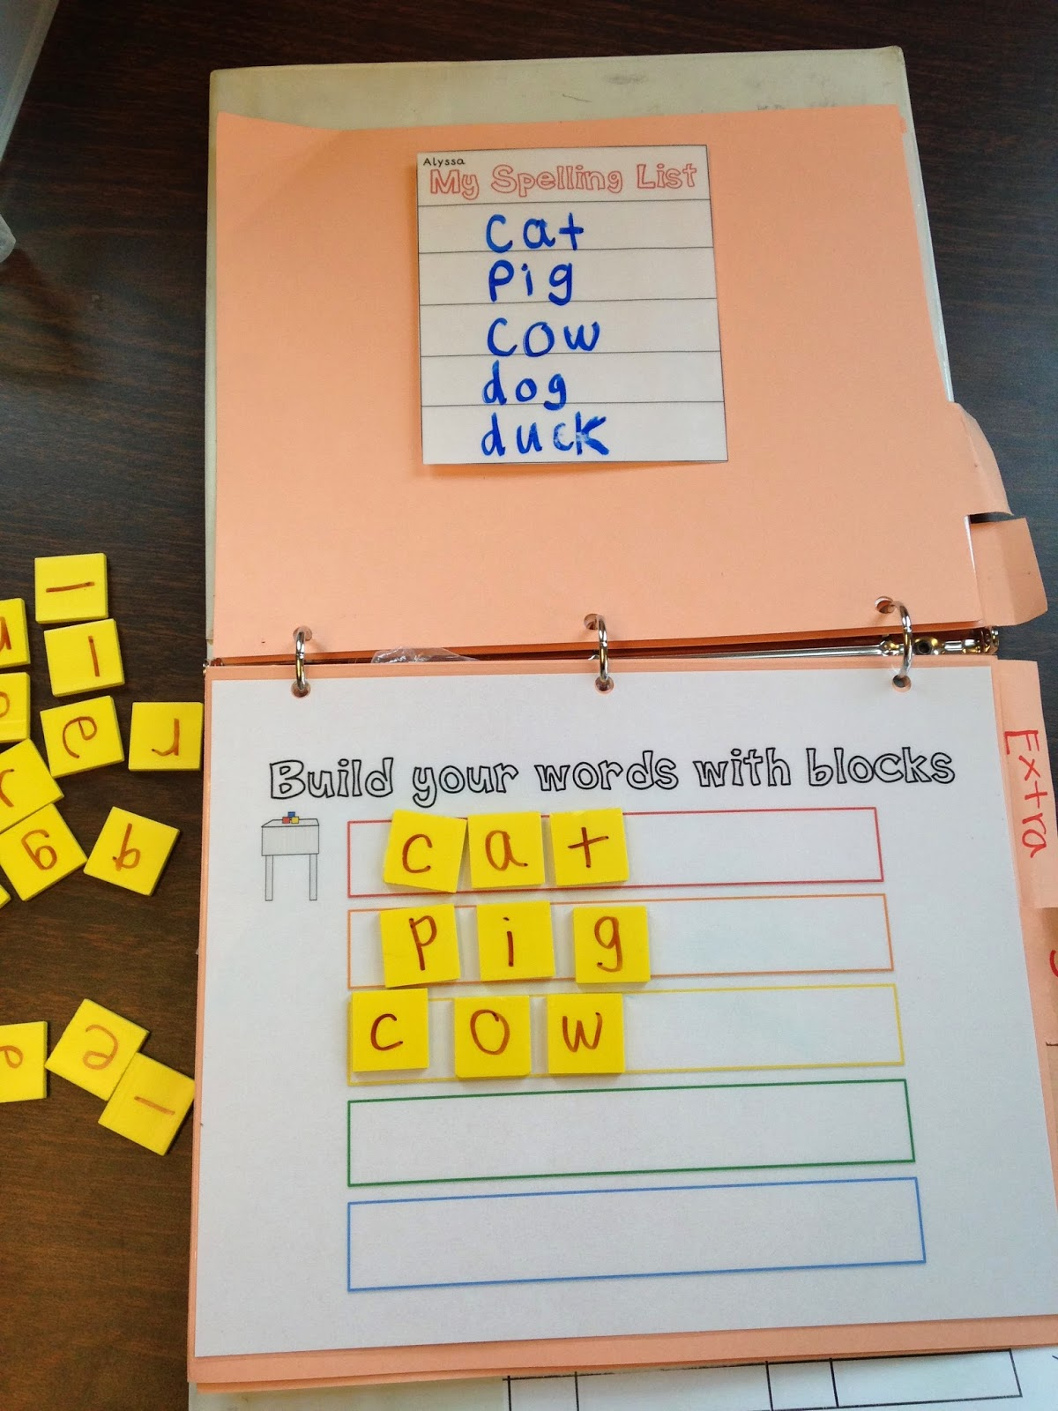
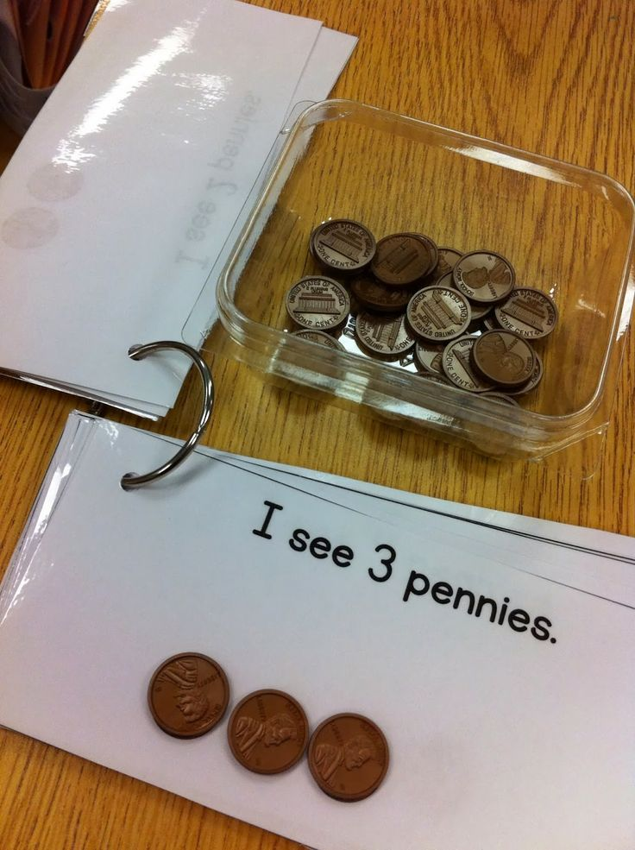
Workboxes

Slide 49
Index cards
Put sentences together with words on index cards
Number sentences with Numbers and + / - / =
Create a mission- Steps that the student has to do
Sight words
Vocabulary quiz
Matching activities

