Slide 1
Self-Care Basics Presented by Jacob Wolf

Slide 2
Awareness Activity
Side One: Strengths and Joys
Draw or list the following:
Strengths
Joys
Activities you enjoy
Hobbies
Goals
Side Two: Fears or Areas of Concern
Draw or list the following:
Fears
Things that induce anger
Concerns/Worries
Barriers
Notes:
Activity: Two-sided sheet of paper

Slide 3
Self-Care is
The practice of taking action to preserve or improve one’s own health
OR
The practice of taking an active role in protecting one’s well-being and happiness, in particular during periods of stress

Slide 4
Self-Care is not
About adding more to your “to-do list”
About an “emergency response plan” when stress becomes overwhelming and are close to burnout
Being selfish

Slide 5
What Can Impact Self-Care?
Increased Stress
Sleep Deprivation
Emotional Triggers and Trauma
Eating habits
Conflict with others
Schedules
and more!!
Notes:
Activity: Complete the ACE Score worksheet

Slide 6
Areas of Self-Care
Physical
Emotional
Professional
Psychological
Social
Environmental
Spiritual
Financial

Slide 7
My Self-Care Plan
A self-care plan is a preventive tool that can be used to guide your self-care. It can be modified at any time and should be evaluated periodically for needed changes.
Notes:
Activity: Self-Care Assessment

Slide 8
Physical Self-Care
Involves movement of the body, health, nutrition, sleep, rest, and physical touch.
Examples:
Going on a walk
Dancing
Getting enough sleep
Eating nourishing foods
Regular meals
Massage
Hugs
Drink enough water
Yoga
Stretching
Bike ride
Nap
Sports
Notes:
TALK ABOUT THE POWER OF FULL ENGAGEMENT
Activity: Consider minute to win it game

Slide 9
Psychological Self-Care
Involves learning new things, applying consequential thinking, engaging intrinsic motivation, practicing mindfulness and creativity
Examples:
Try a new activity
Reading a book
Learning or teaching a new skill
Doing a digital or social media detox
Practicing mindfulness
Make art / craft project
Word search
Take action on one thing you have been avoiding
Service for others
Drive home in silence
Read about a new topic/genre
Complete things on your to-do list
Notes:
Activity: Self-Care Word Search

Slide 10
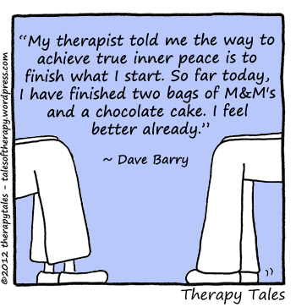

Slide 11
Emotional Self-Care
Enhancing emotional literacy, navigating emotions, increasing empathy and managing stress effectively.
Examples:
Gratitude Jar/Journal
Saying no to others
Saying yes to yourself
Take time to reflect on feelings
Be aware of your own boundaries
Write down your feelings
Laugh
Practice self-compassion
Cry when you need to
Express your feelings with others
Be honest (with self and others)
Have fun
Read some jokes
Notes:
Activity:
1) Two minutes to list out all the things you are grateful for
2) Look up bad dad jokes

Slide 12
Social Self-Care
Involves having a supportive group and network of relationships around you whom you trust and turn to when required. Having caring and supportive people around you builds a sense of belonging and connectedness.
Examples:
Belong to groups outside of work
Honor your commitments to others
Ask for help when needed
Meet new people
Go walking with family/friends
Go on a lunch date with friends
Call a family/friend on the phone
Post positive comments on friends social media posts
Look through old pictures of family and friends
Join a support group
Go on a date

Slide 13
Professional Self-Care
Involves sharing your strengths and gifts, having clear professional boundaries, whilst living your purpose.
Examples:
Eating a nourishing lunch each day at work
Develop work routines
Advocate for your needs
Set clear professional boundaries
Know your roles and responsibilities
Attending professional development
Seek coaching
Develop professional goals
Serve others at your work
Have fun at work!
Notes:
Activity: Professional Self-Care Worksheet

Slide 14
Environmental Self-Care
Involves having an organized, well-maintained and clutter-free work, business and home environment, having clean clothes and a clean and well-maintained mode of transport.
Examples:
Declutter your home or work environment
Recycle
Monitor technology time
Cleaning up after meal
Make your bed in the morning
Clean your car
Create a cleaning checklist/schedule
Identify a location for your belongings

Slide 15
Financial Self-Care
Involves being responsible with your finances (i.e., living expenses, income, insurances, savings, etc.) and having a conscious relationship with money.
Examples:
Know where your money is going
Know when expenses are due and pay on time
Keep insurance up to date
Open savings account
Spend money wisely
Have an emergency fund
Be charitable to others

Slide 16
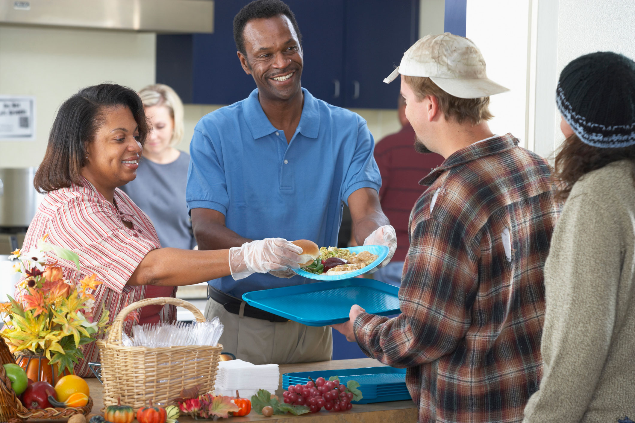
Spiritual Self-Care
Involves the beliefs and values that are important to you and guide your life, including pursuit of your noble goals and practices that support you developing spiritual awareness.
Examples:
Volunteering at local organization
Go on a retreat
Walk in nature
Prayer or meditation
Read inspirational books
Read poetry
Attend church
Create an inspiring quote notebook
Write in a journal
Create a grateful journal
Drop off a meal for someone in need
Justserve.org
Notes:
Activity:
1) Justserve.org

Slide 17
Take a couple final minutes to add more detail to your self-care plan

